Slide 1
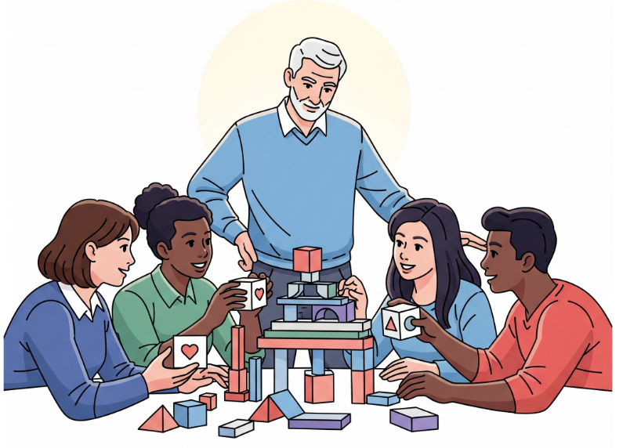
The Human Element of Tech Leadership
Insights from 30 Years in Technology
By Randy Hinders

Slide 2

The Human Element of Tech Leadership
It's Not Just About the Code.
Your Most Powerful Tool Isn't a Tool. It's Your EQ.
Why Your Team Needs Your EQ.
Case Study: The Misunderstood Architecture.
Leveling Up Your Emotional Intelligence.
The Ultimate Legacy.
From Manager to Mentor and Coach.
Case Study: The Engineer Who Found Their Voice.
The Purpose of Tech Leadership.

Slide 3
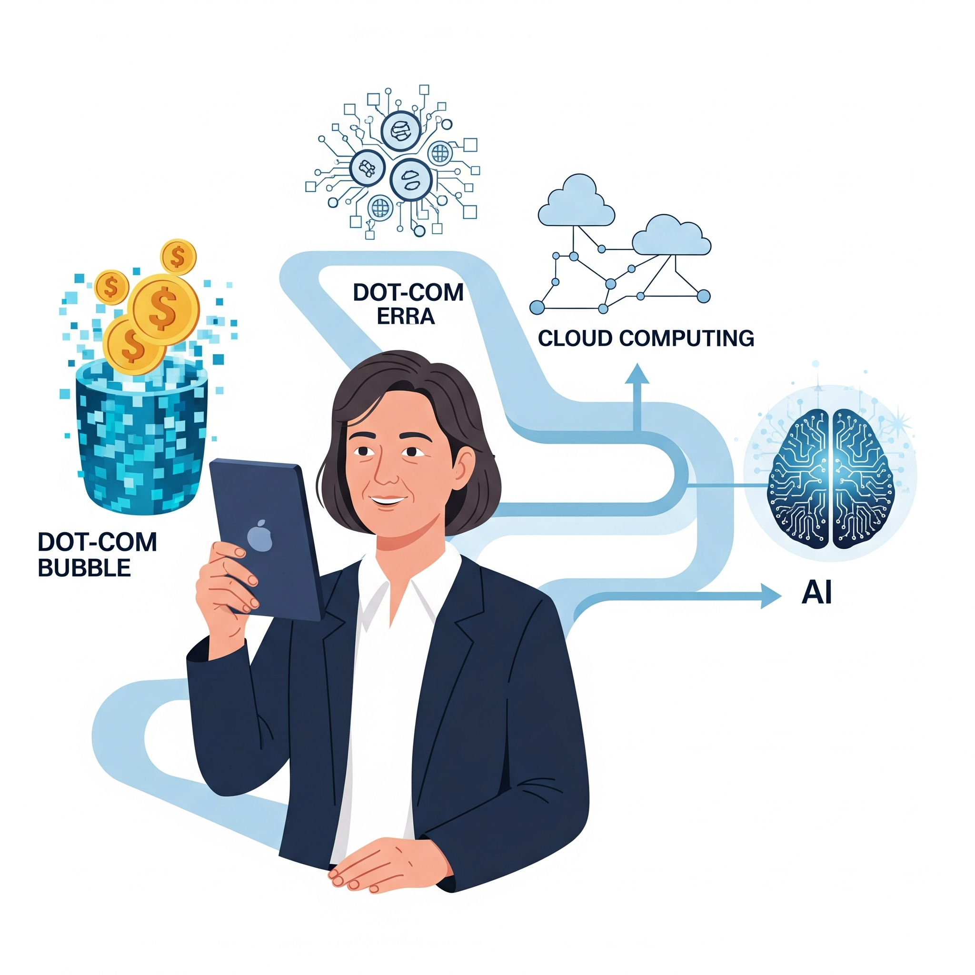
It's Not Just About the Code.
30 years in IT, 15+ in leadership. I've seen it all—from the dot-com bubble to the rise of cloud computing and now AI.
Through it all, the biggest challenges and most significant successes were never purely technical.
Today, we'll talk about the two human superpowers that define a truly great tech leader.

Slide 4

Your Most Powerful Tool Isn't a Tool. It's Your Emotional Intelligence (EQ).
This isn't just a soft skill. In a high-pressure, constantly changing environment, it is a strategic necessity.
It's about understanding the motivations of your team, sensing unsaid frustrations, and creating a safe space for people to do their best work.

Slide 5
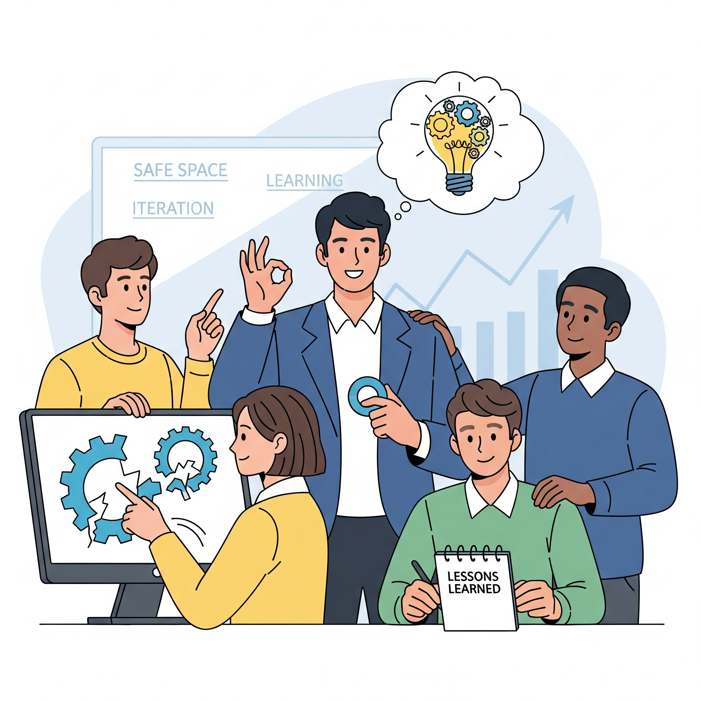
Why Your Team Needs Your EQ.
Enables a "Fail-Fast" Culture: Perfection is an illusion. An emotionally intelligent leader creates a safe space where it’s okay for a development environment to have issues and for a feature to break. Mistakes are not a point of failure, but a point of learning.
Fosters Iteration and Excellence: The goal is not perfection on the first try, but excellence over time. This mindset, rooted in empathy, allows teams to iterate, learn from each other's experiences, and deliver better results consistently.
Increases Engagement and Performance: People are more motivated when they feel valued as individuals, not just as cogs in a machine.
Reduces Conflict and Friction: Developing rapport helps you anticipate and de-escalate disagreements before they become major blockers.

Slide 6
Why Your Team Needs Your EQ.
Enables a "Fail-Fast" Culture: Perfection is an illusion. An emotionally intelligent leader creates a safe space where it’s okay for a development environment to have issues and for a feature to break. Mistakes are not a point of failure, but a point of learning.
Fosters Iteration and Excellence: The goal is not perfection on the first try, but excellence over time. This mindset, rooted in empathy, allows teams to iterate, learn from each other's experiences, and deliver better results consistently.
Increases Engagement and Performance: People are more motivated when they feel valued as individuals, not just as cogs in a machine.
Reduces Conflict and Friction: Developing rapport helps you anticipate and de-escalate disagreements before they become major blockers.
1St Superpower is EQ

Slide 7
Case Study: The Misunderstood Architecture.
The Problem: Two senior developers were at a standstill, each insisting their technical approach was the only way forward. Their disagreement was stalling the entire project.

Slide 8
Case Study: The Misunderstood Architecture.
The Problem: Two senior developers were at a standstill, each insisting their technical approach was the only way forward. Their disagreement was stalling the entire project.
My Mistake: Insisting they "just figure it out" and solve the technical problem, thinking it was a simple design disagreement.

Slide 9
Case Study: The Misunderstood Architecture.
The Problem: Two senior developers were at a standstill, each insisting their technical approach was the only way forward. Their disagreement was stalling the entire project.
My Mistake: Insisting they "just figure it out" and solve the technical problem, thinking it was a simple design disagreement.
The Shift: I sat with each of them individually and found they were using different technical terms for the same architectural concept. Their disagreement was purely semantic.

Slide 10
Case Study: The Misunderstood Architecture.
The Problem: Two senior developers were at a standstill, each insisting their technical approach was the only way forward. Their disagreement was stalling the entire project.
My Mistake: Insisting they "just figure it out" and solve the technical problem, thinking it was a simple design disagreement.
The Shift: I sat with each of them individually and found they were using different technical terms for the same architectural concept. Their disagreement was purely semantic.
The Resolution: I facilitated a meeting, not to solve the technical issue, but to help them translate their vocabularies. Once they realized they were aligned, they quickly moved forward.

Slide 11
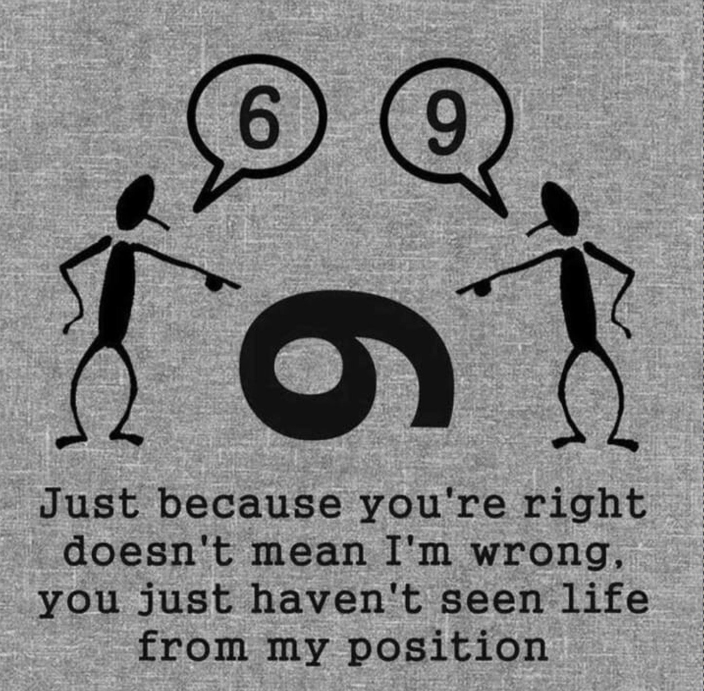
Case Study: The Misunderstood Architecture.
The Problem: Two senior developers were at a standstill, each insisting their technical approach was the only way forward. Their disagreement was stalling the entire project.
My Mistake: Insisting they "just figure it out" and solve the technical problem, thinking it was a simple design disagreement.
The Shift: I sat with each of them individually and found they were using different technical terms for the same architectural concept. Their disagreement was purely semantic.
The Resolution: I facilitated a meeting, not to solve the technical issue, but to help them translate their vocabularies. Once they realized they were aligned, they quickly moved forward.

Slide 12
Case Study: The Misunderstood Architecture.
The Problem: Two senior developers were at a standstill, each insisting their technical approach was the only way forward. Their disagreement was stalling the entire project.
My Mistake: Insisting they "just figure it out" and solve the technical problem, thinking it was a simple design disagreement.
The Shift: I sat with each of them individually and found they were using different technical terms for the same architectural concept. Their disagreement was purely semantic.
The Resolution: I facilitated a meeting, not to solve the technical issue, but to help them translate their vocabularies. Once they realized they were aligned, they quickly moved forward.
The Lesson: The technical conflict was a symptom of a human-element problem—a communication gap. My role was to bridge that gap.

Slide 13
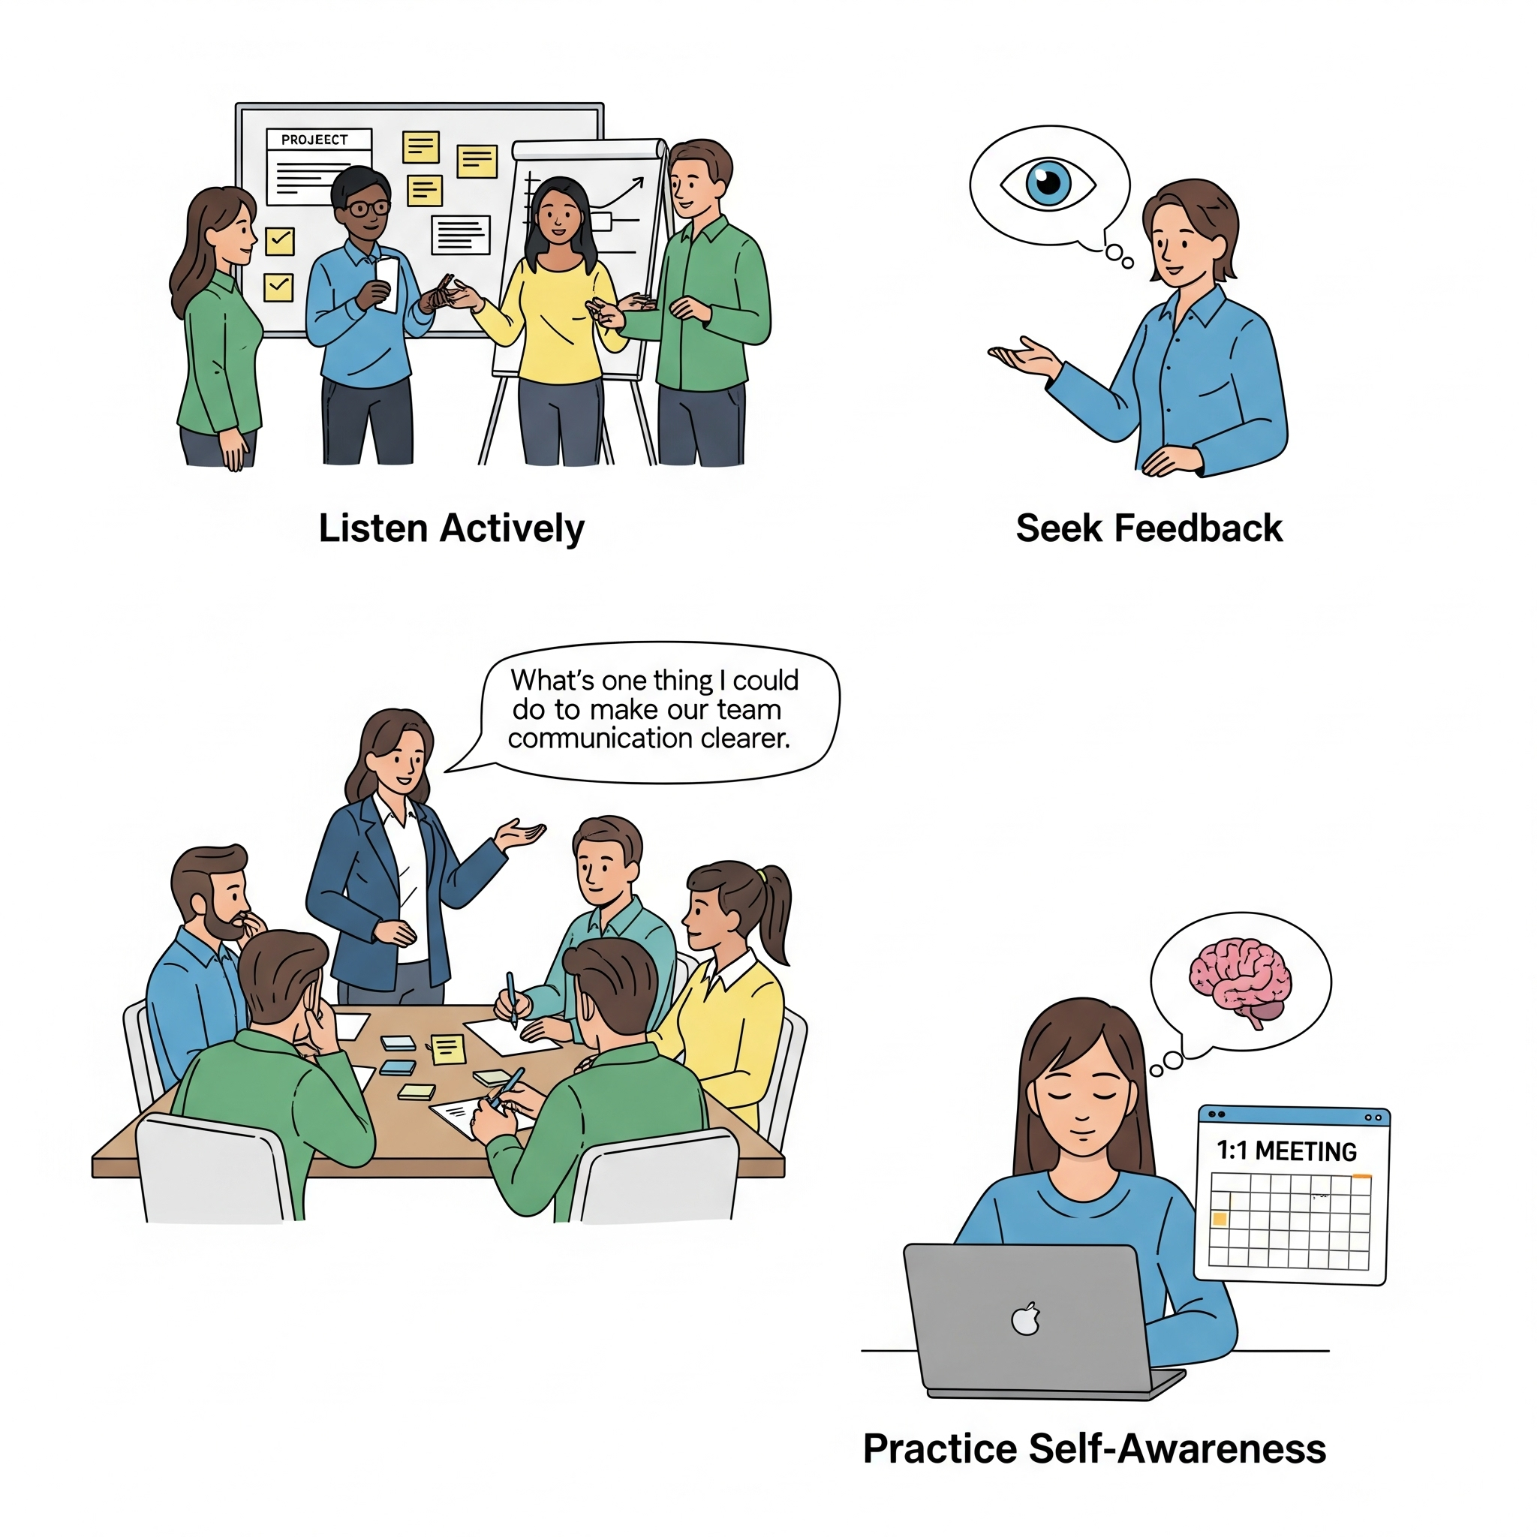
Leveling Up Your Emotional Intelligence.
Listen Actively: In your next stand-up, don't just ask for status updates. Observe. Pay attention to body language. Who is hesitant? Who isn't speaking up? The most important information is often unspoken.
Seek Feedback: In your next retrospective, dedicate a few minutes to ask for specific feedback on your leadership. Something like, "What's one thing I could do to make our team communication more clearly?"
Practice Self-Awareness: Before your next 1:1, take 30 seconds to check in with yourself. How are you feeling? What's your current mindset? Understanding your own emotional state is the first step to controlling your reactions under pressure.

Slide 14
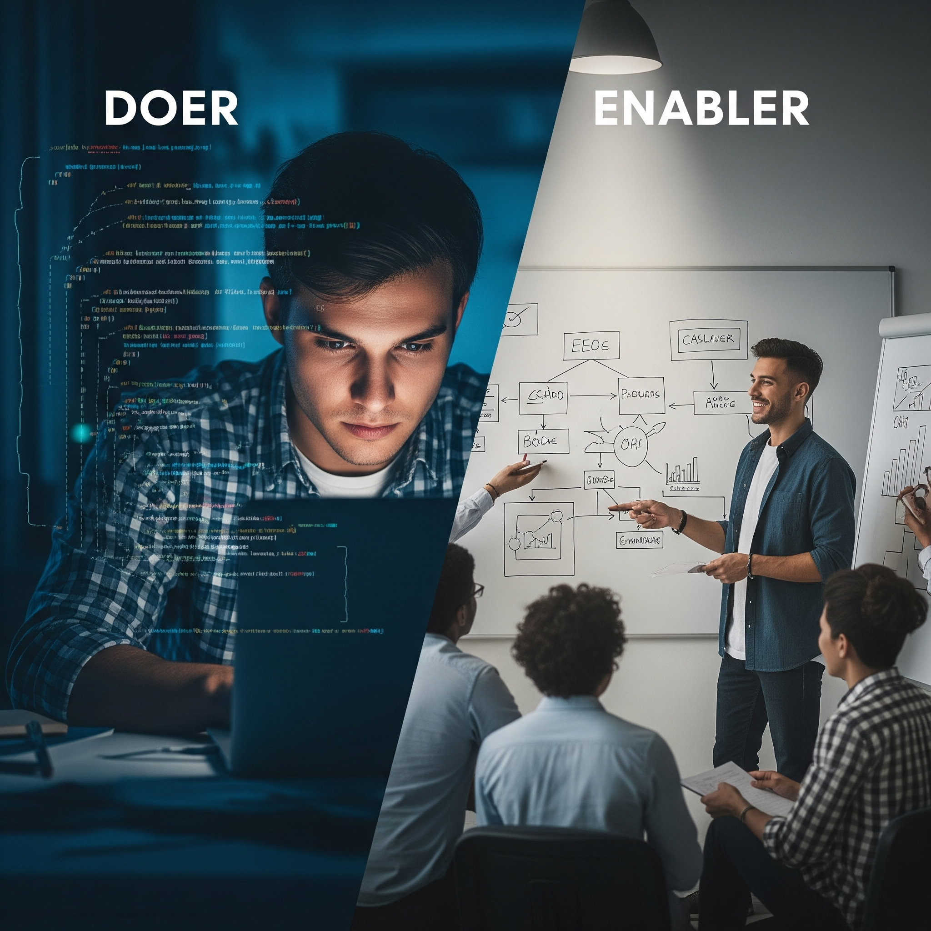
The Ultimate Legacy.
As a leader, your job fundamentally changes. You're no longer judged by the code you write, but by the code your team writes.
Your greatest creation won't be a piece of software or a new system. It will be the people you mentored and the teams you built.
This is the transition from "Doer" to "Enabler."

Slide 15

From Manager to Mentor and Coach.
Your New Job Description: You are a coach. Your job is to provide clarity, remove obstacles, and help people realize their full potential.
Career Check-ins: Go beyond project updates in your one-on-ones. Ask about career goals, what they're struggling with, and how you can help them grow.
Be a Connector: Connect people to opportunities, to other leaders who can help them, and to resources for learning.

Slide 16
Case Study: The Engineer Who Found Their Voice.
The Situation: I had a brilliant, but very quiet, engineer who was technically far ahead of her peers. They were a key part of every successful project.

Slide 17
Case Study: The Engineer Who Found Their Voice.
The Situation: I had a brilliant, but very quiet, engineer who was technically far ahead of her peers. They were a key part of every successful project.
My Approach: I recognized their potential beyond just day to day tickets. I encouraged them to present their work, to lead small team discussions, and to step out of their comfort zone.

Slide 18
Case Study: The Engineer Who Found Their Voice.
The Situation: I had a brilliant, but very quiet, engineer who was technically far ahead of her peers. They were a key part of every successful project.
My Approach: I recognized their potential beyond just day to day tickets. I encouraged them to present their work, to lead small team discussions, and to step out of their comfort zone.
The Outcome: This individual went from a quiet contributor to a confident team lead and is now a manager over at CareSource.

Slide 19

Case Study: The Engineer Who Found Their Voice.
The Situation: I had a brilliant, but very quiet, engineer who was technically far ahead of his peers. They were a key part of every successful project.
My Approach: I recognized their potential beyond just day to day tickets. I encouraged them to present their work, to lead small team discussions, and to step out of their comfort zone.
The Outcome: This individual went from a quiet contributor to a confident team lead and is now a manager over at CareSource.
The Lesson: The talent was always there. My role was to provide the stage and the encouragement.

Slide 20
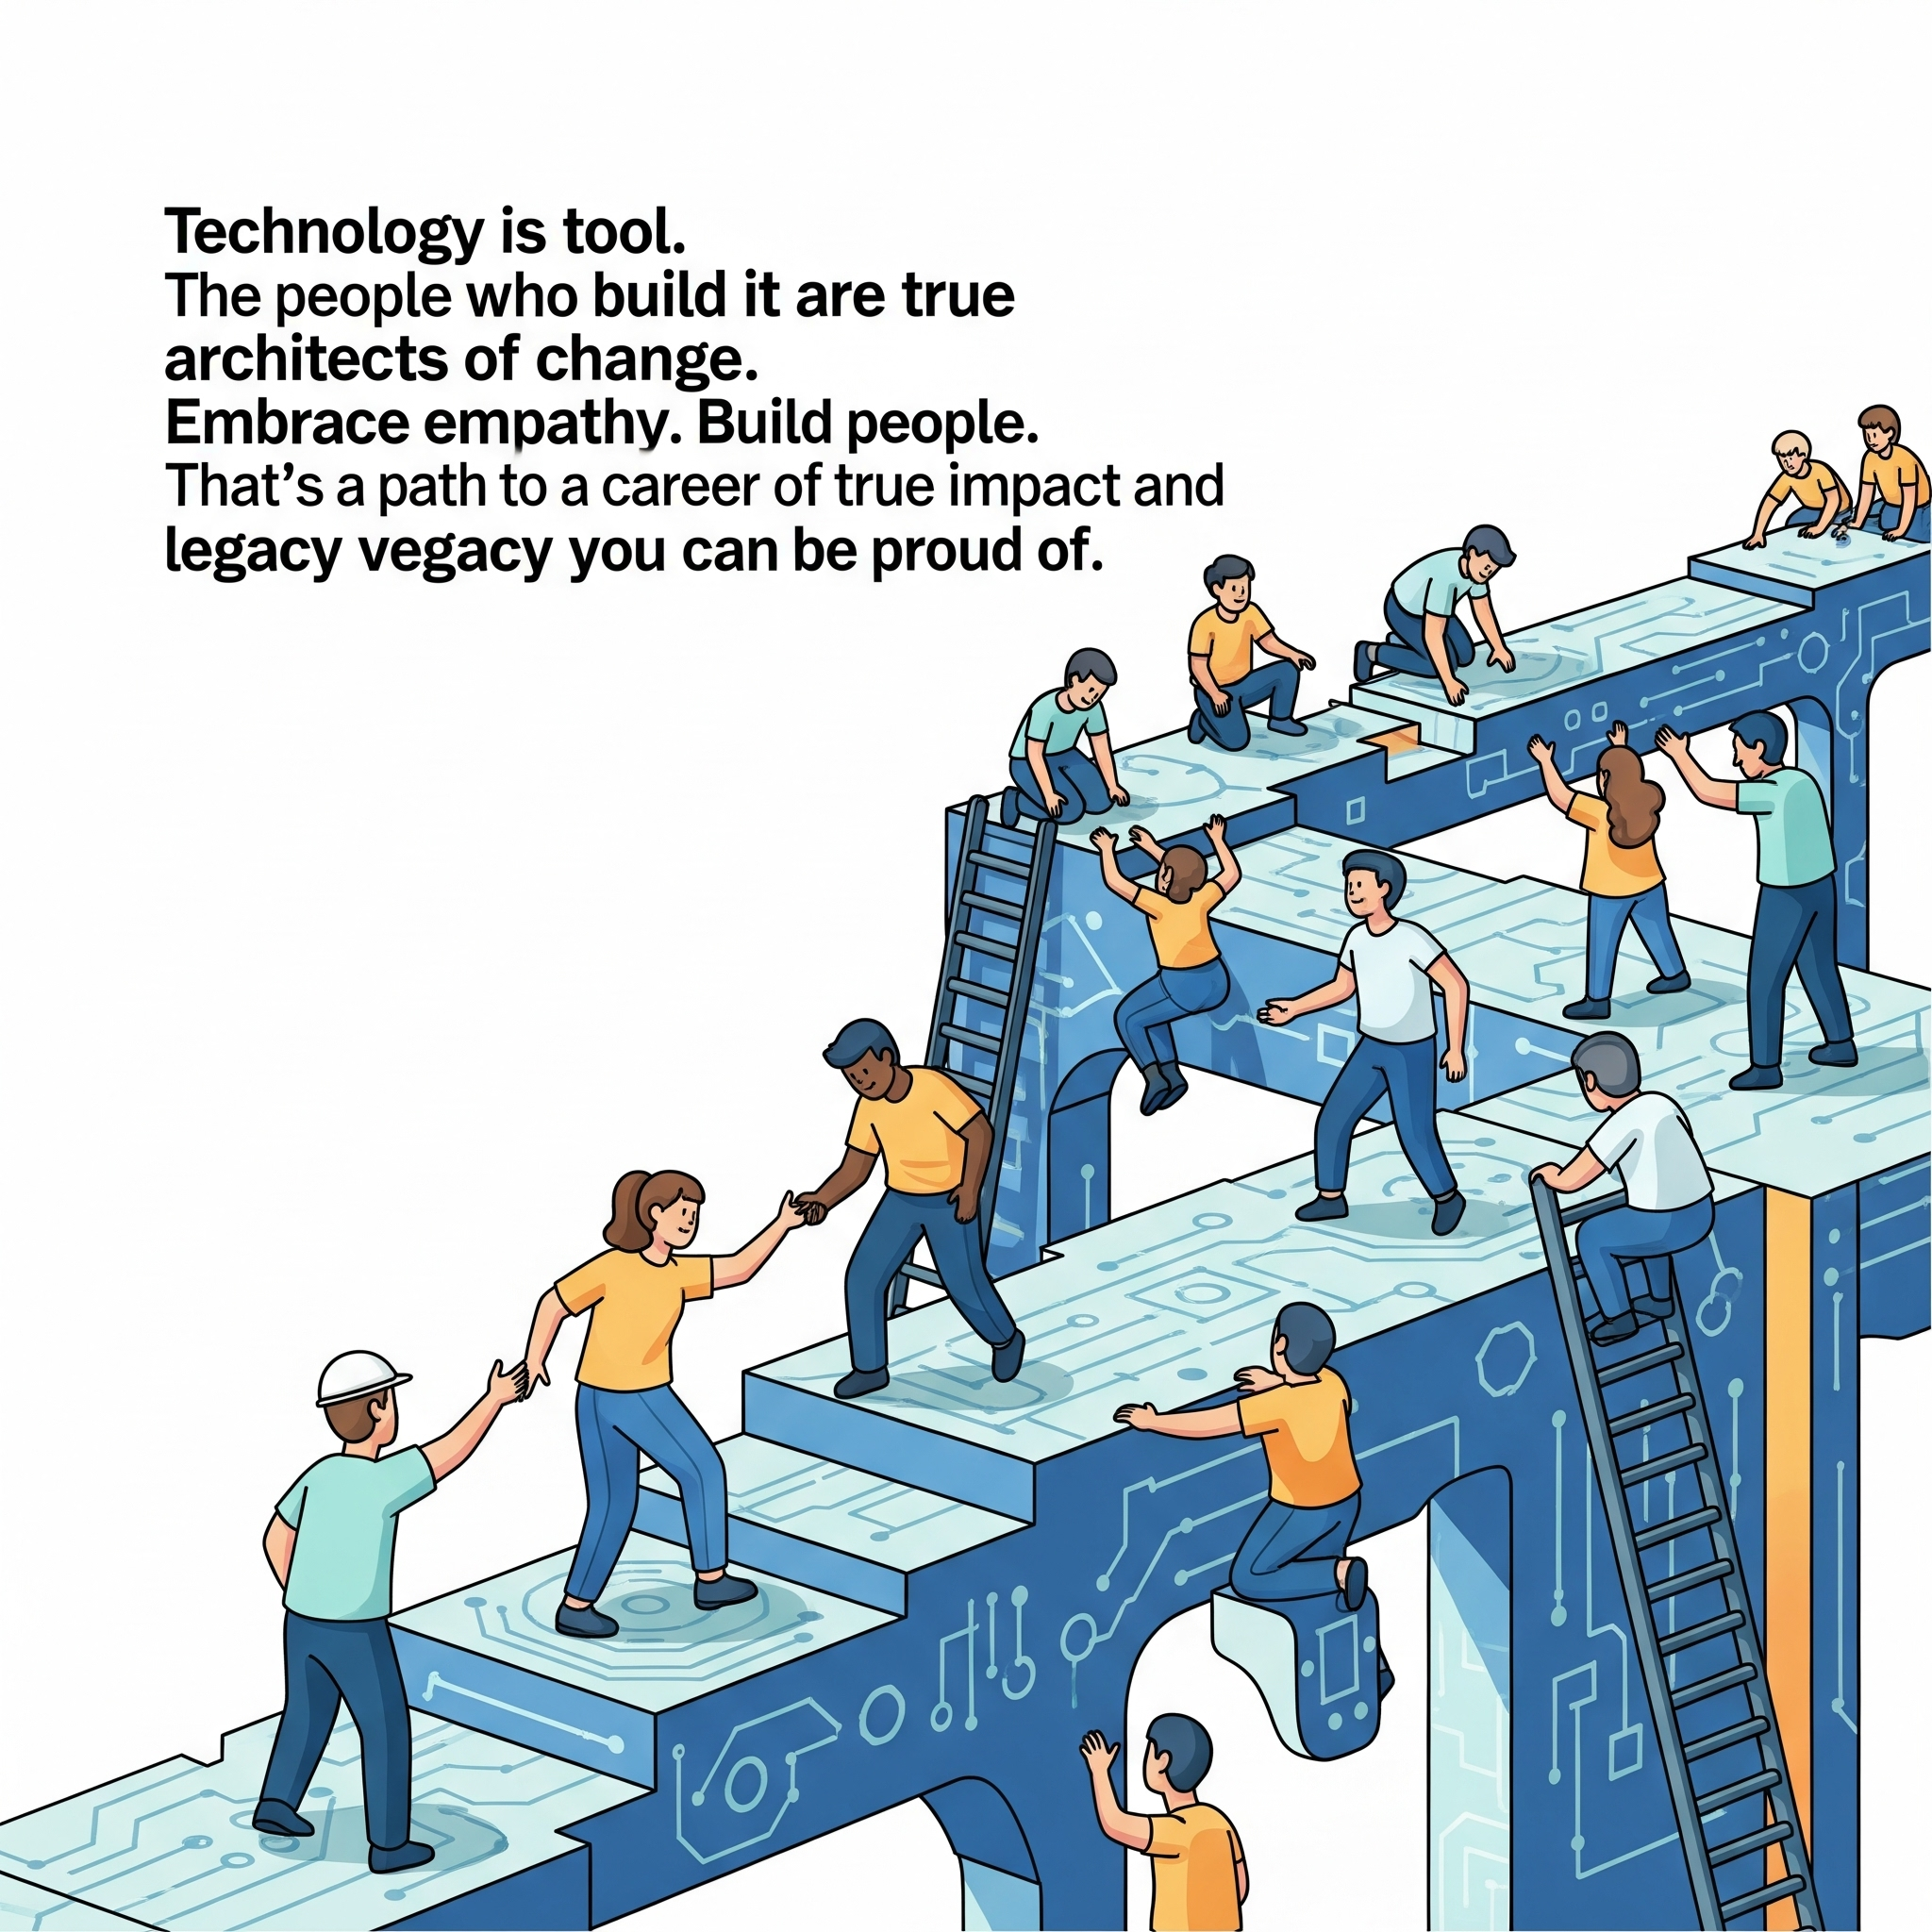
The Purpose of Tech Leadership.
Technology is a tool. The people who build it are the true architects of change.
Embrace empathy. Build people.
That's the path to a career of true impact and a legacy you can be proud of.

Slide 21
The Purpose of Tech Leadership.
Technology is a tool. The people who build it are the true architects of change.
Embrace empathy. Build people.
That's the path to a career of true impact and a legacy you can be proud of.
2nd Superpower is Empathy

Slide 22
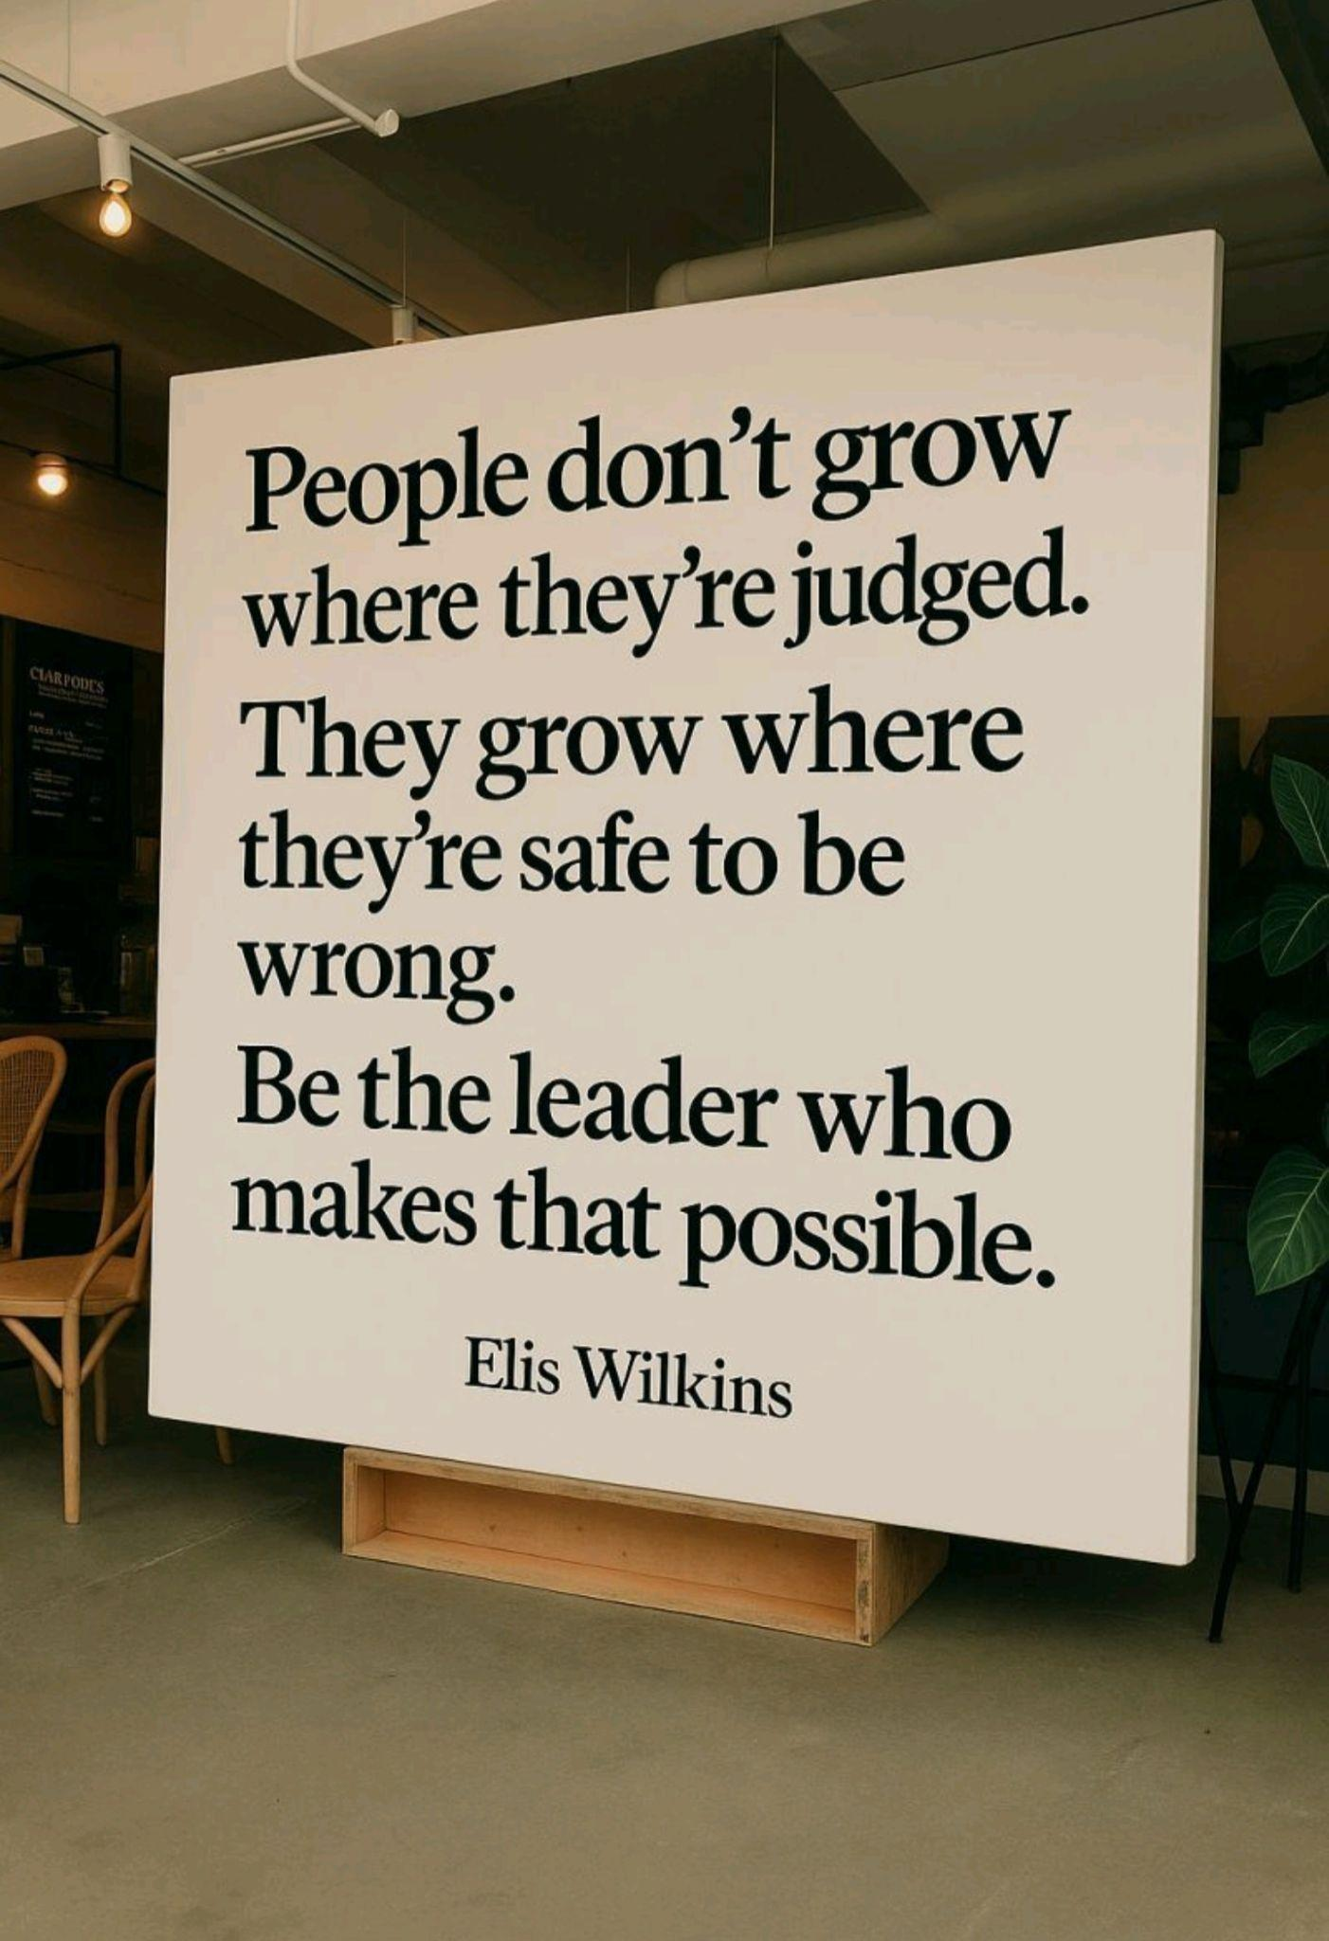

Slide 23

Let's Talk: Q&A
Thank You
Find me on LinkedIn @
www.linkedin.com/in/randyhinders/

Slide 24
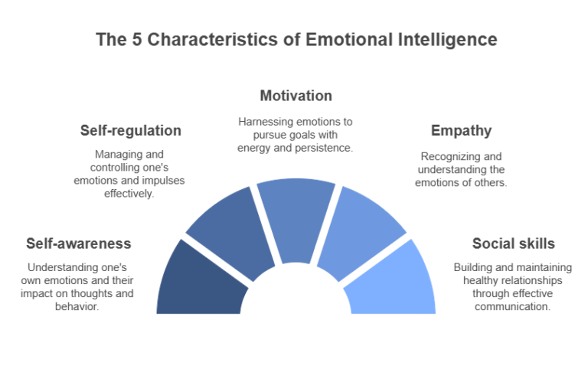

Slide 25
Having a lot of empathy is a sign of high emotional intelligence (EQ), as it is a fundamental component of understanding and responding to the emotions of others. High-EQ individuals are able to identify, understand, and manage emotions in themselves and others, with empathy being a core trait that allows them to connect with and support people effectively

Slide 26
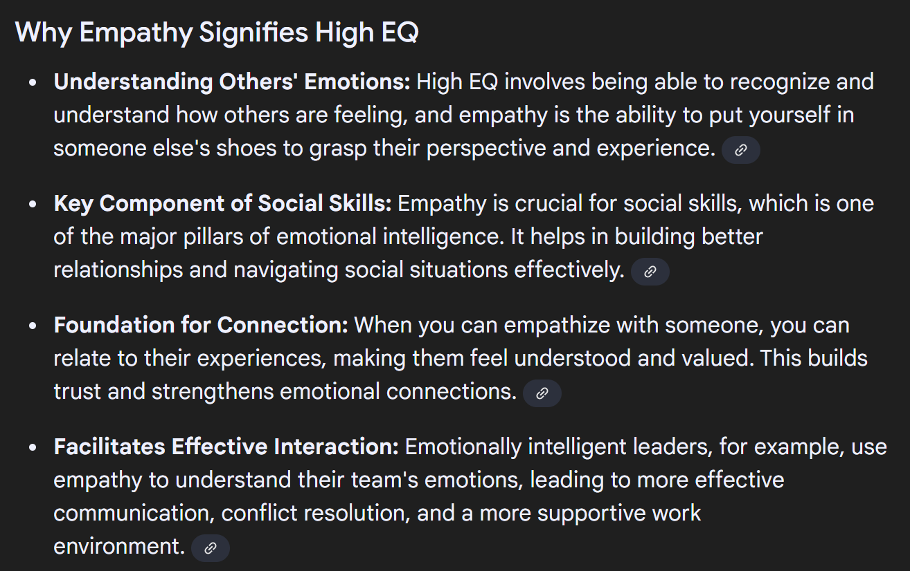

Slide 27
